Slide 1
Understanding SQL Server R Services
Bob Ward
Principal Architect, Microsoft
Data Group, Tiger Team
Want decks and demos now? http://aka.ms/bobwardms
Credits to Joe Sack, Arvind Shyamsundar, and the SQL R Team
bobward@microsoft.com
@bobwardms
http://aka.ms/bobsql

Slide 2
What will we cover today
Why SQL Server R Services?
What gets installed?
The SQL Server Extensibility Architecture
R and SQL Server Together
R with SQL Server is Scalable and Secure
Resource Pools, Best Practices, Monitoring, and Troubleshooting
SQL Server and R at Scale

Slide 3
Demo: Just Show Us!
Notes:
Follow the instructions in justshowus\readme.txt

Slide 4
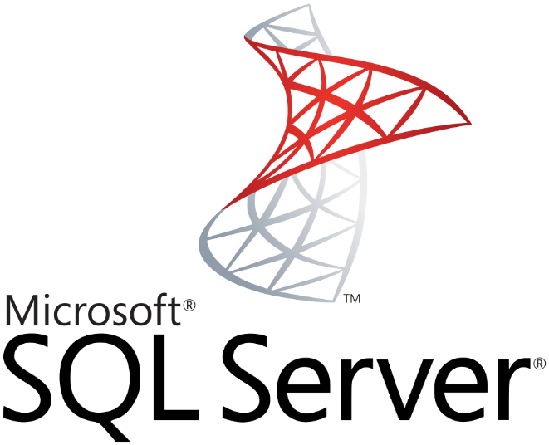

Why SQL Server and R?
R Services (In-Database)
Familiar
Scalable
Secure
T-SQL
SQLOS
DMVs
Resource Governor
XEvent
Query Store
LOG files
Seconds and ms
R Open
R Client (R Studio)
ScaleR
R Server
R Data Sources
Hours and Days
SQL Server and Microsoft R
Notes:
What does R mean in “R services”. R is a statistical computing programming language based on an Open Source Standard, R Open.

Slide 5
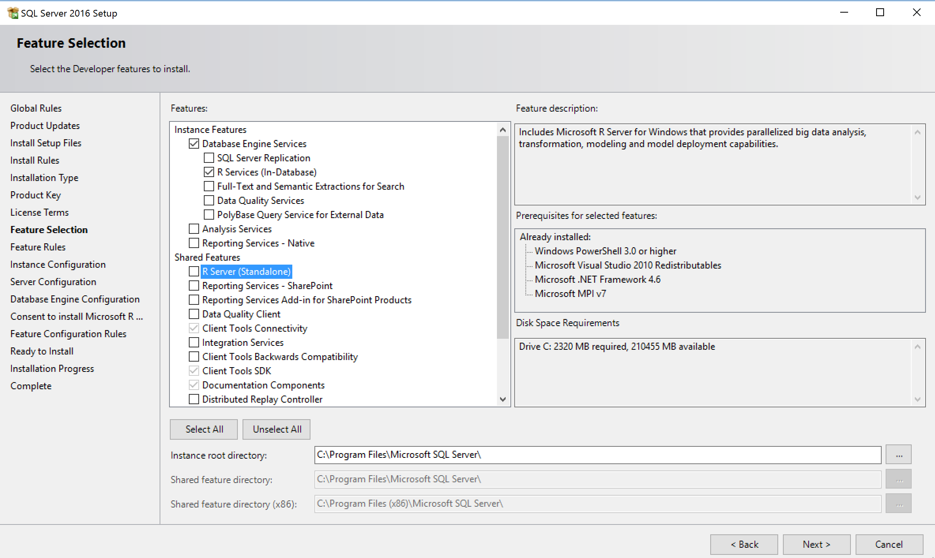
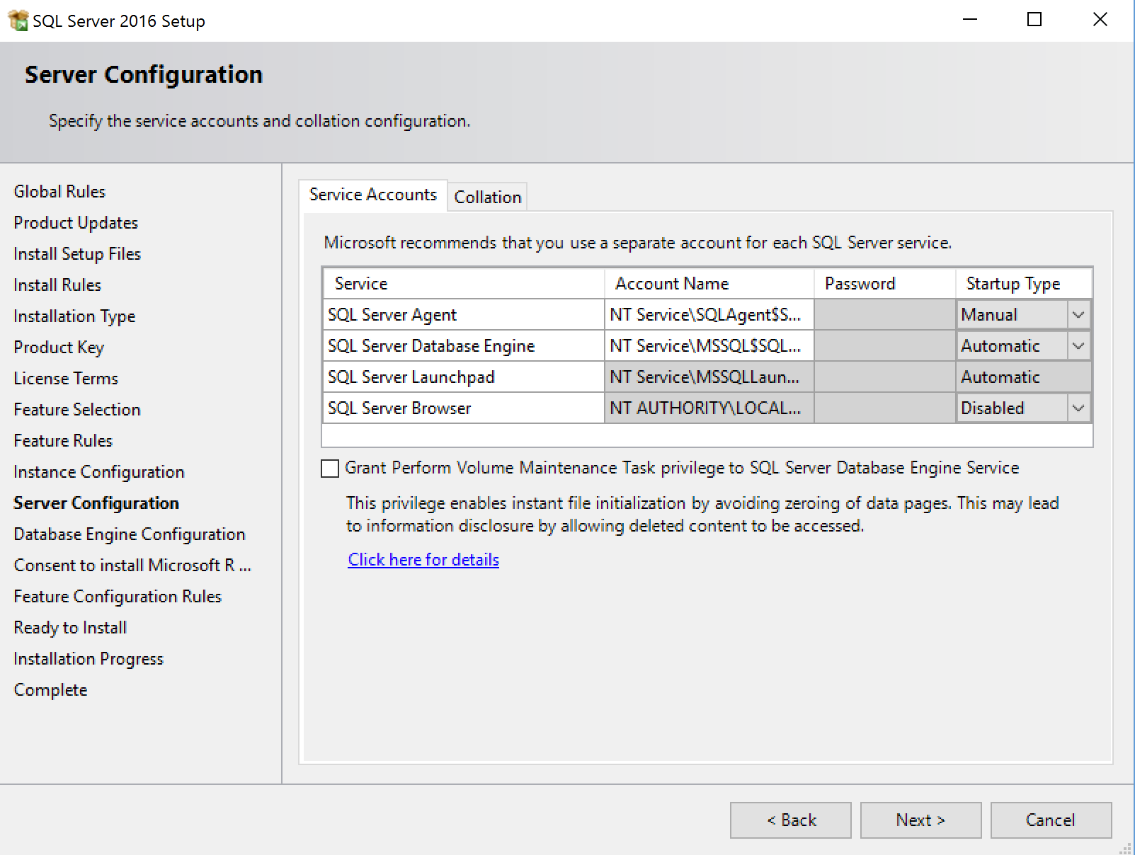
What Gets Installed?
Not installed by default in Azure VM
Some differences by edition
SQL Server R Services
Microsoft R Server
Notes:
MPI is Messaging Passing Interface and is used by R and ScaleR to support parallel computing: https://msdn.microsoft.com/en-us/library/bb524831(v=vs.85).aspx

Slide 6
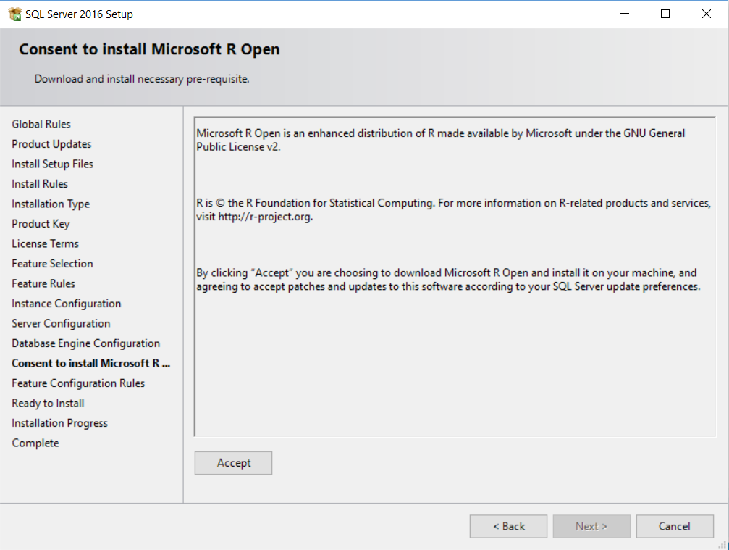
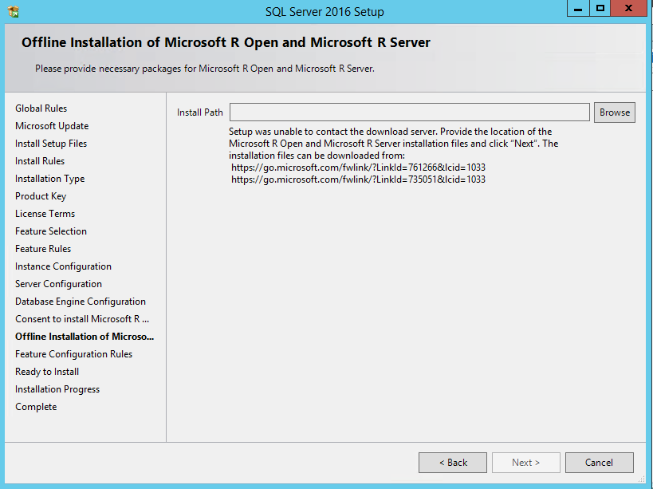
What Gets Installed?
The offline experience
You must download both
Open Source R Package
Microsoft R Package
A few things to do for Azure VM
CUs and SPs will have new download packages
Don’t forget /IACCEPTROPENLICENSETERMS for unattended installs
Rsetup.exe and rsetup.log
Notes:
This is one of the very few scenarios where setup has to connect to the internet

Slide 7

The SQL Extensibility Architecture
Each SQL instance has a launchpad
MSSQLSERVER Service
MSSQLLAUNCHPAD Service
Windows “satellite” process
Windows “satellite” process
launchpad.exe
Windows “satellite” process
sqlservr.exe
Windows “satellite” process
Named pipe
sp_execute_external_script
“launcher”
“What” and “How”
to “launch”
SQLOS
XEvent
Windows “satellite” process
sqlsatellite.dll
Notes:
Talk about other “extensible” environments we have used in the past
xproc
sp_OA
Linked servers
Full-text

Slide 8
sp_execute_external_script
Getting started with R docs installed in R_SERVICES\doc
R is only currently supported script language today
execute sp_execute_external_script
@language = N'R'
, @script = N'
x <- as.matrix(InputDataSet);
y <- array(dim1:dim2);
OutputDataSet <- as.data.frame(x %*% y);'
, @input_data_1 = N' SELECT [Col1] from MyData;'
, @params = N'@dim1 int, @dim2 int'
, @dim1 = 12, @dim2 = 15
WITH RESULT SETS (([Col1] int, [Col2] int, [Col3] int, [Col4] int));
R script. Use a @var or read from a file
Input data for script. Can be any T-SQL SELECT.
Parameters for script. OUTPUT supported
Messages can also be returned including STDOUT and STDERR
Result set binding
Notes:
sp_execute_external_script is an example of a special proc or specproc. The source code of the procedure can’t be found in the resource db. It is implemented in our source code

Slide 9
T-SQL and R
“Input data” queries traced like any other query
sp_execute_external_script from T-SQL client
SQL Server Compute Context from R client
RODBC data source in R scripts
Lessons learned with customers from SQLCAT
SQL query tuning
Some R scripts work better as T-SQL (Ex. Result set aggregation)
Develop, Train, and Operationalize
R Client to develop, explore and experiment
Train a model with sp_execute_external_script and save the result to a table
Operationalize by using sp_execute_external_script to “run” the model
Encapsulate in stored procedure for SQL clients

Slide 10
R Integration with SQL Server
docs
Windows Job Object
process pool
This is all local!
Local User Account
MSSQLSERVER Service
MSSQLLAUNCHPAD Service
rterm.exe
Service SID
Service SID
Open R
sqlservr.exe
launchpad.exe
conhost.exe
rlauncher.dll
rxlink.dll
sp_execute_external_script
pipe
CreateProcess
pipe
rlauncher.dll
CreateProcess
Local User Account
rlauncher.dll
compile input data query
Send message to pipe
Execute input query
Push results
Pull results
BxlServer.exe
R script
SQLOS
XEvent
ScaleR
“satellite” process
interleaved
SNI/TCP – Comm technology as SQL
Retrieve input rows and params
Send back results and output params
stdout and stderr
sqlsatellite.dll
SATELLITE_* wait type
Notes:
We deploy a “process pool” when launching scripts so when you run a script execution you will see more than one rterm/bxlserver pair. Since rterm is a windows console app you will also see a conhost.exe for each rterm.exe
Rterm = R runtime command interpreter
Bxlserver = Microsoft R Server process which also hosts sqlsatellite.dll

Slide 11
Demo: Inside SQL Server and R
Notes:
Follow the instructions in insidesqlr\readme.txt

Slide 12
R Services (In-Database) is scalable
Enterprise Edition gives you the optimum scalability
More efficient than standalone R clients
Data does not have to all fit in memory
Reduced data transmission over the network
Most R Open functions are single threaded
Use the ScaleR APIs for scalable R scripts that are multi-threaded on the SQL Server computer
We can stream data in parallel and batches from SQL Server
Use the power of SQL Server and R Server to develop, train, and execution
SQL Server Compute Context
T-SQL queries
Columnstore indexes
Data compression
Parallel query execution
Stored procedures
It’s all about using the compute power of the server close to the data
Notes:
Perhaps the #1 reason why SQL R Services is a value proposition is because we are pushing the computing power of SQL Server queries and R scripts to the server leaving the R client to analyze the results (such as plots)

Slide 13
R Services (In-Database) is secure
Reduced surface area and isolation
‘external scripts enabled’ required
R script execution outside of SQL Server process space
Script execution requires explicit permission
sp_execute_external_script requires EXECUTE ANY EXTERNAL SCRIPT for non-admins
SQL Server login/user required and db/table access
Satellite processes has limited privileges
Satellite processes run under local user accounts in the SQLRUserGroup
Each execution is isolated. Different users with different accounts
Windows firewall rules to block outbound traffic
MSSQLSERVR0n

Slide 14
Best Practices and Performance Considerations
docs recommend min 32Gb
Computer with enough cores, memory, and disk speed
High Performance Power Option
Balance memory needed by SQL Server and external pool
Launchpad needs specific privileges
Be sure SQLRUserGroup has log on local rights
Restart the SQL Server Service not stop/start (Launchpad is dependent)
8dot3 notation needs to be enabled. Read more here
Remote ODBC execution requires SQLRUserGroup login
20 unique users allowed to execute R scripts concurrently by default
SQL Server Query and Index design still apply
R scripts can often benefit from tuning
Default max memory is 20% of RAM
Need to add more?

Slide 15
SQL Server External Resource Pools
Windows Job Objects
internal, default, “user”, and now external
Controls resources for external processes through Launchpad.
Default external pool and user external pools. User classifier function supported
The controls
MAX_CPU_PERCENT – Max CPU percentage for external processes
MAX_PROCESSES – Max number of external processes
MAX_MEMORY – Max committed memory % for external processes
AFFINITY – Control NODEs or CPUs for external processes
Each pool requires a separate job object
dynamic
Min is 12 due to process pool. conhost.exe doesn’t count. 0 = unlimited

Slide 16
Managing, Monitoring, and, Troubleshooting
DMVs
dm_external_script_execution_stats – monitor ScaleR API executions
dm_external_script_requests – active script execution
Perfmon counters: SQL Server:External Scripts
Extensibility LOGs and R Services LOGs in LOG\ExtensibilityLog directory
XEvents
Events for SQL Server, Launchpad, and external processes
Configuration file needed for Launchpad and external processes
procexp and procmon from sysinternals
SQL Server 2016 CU1 has some important fixes
R profiler for performance tuning of R scripts

Slide 17
The SQL Server R Lifecycle
Encapsulate in a stored procedure
R Client
Migrate to ScaleR
SQL Compute Context
Some R scripts to T-SQL
Install R Services (In Database)
Develop model
Train and save model
Operationalize the model
Tune and configure for production
Enable and verify
SQL query tuning
R script tuning
Batch size
Resource Governor
sp_execute_external_script
sp_configure
“hello world test”

Slide 18
SQL Server and R @ Scale
Fraud detection at 1 million predictions per second
SQL Server R 100 times faster at price optimizations for airline tickets and hotel rooms price predictions

Slide 19
Resources
Start here with the docs
SQL team blog post
Experiences from the SQLCAT team
bobsql blog series
Tiger team blog series
Revolution Analytics blog series

Slide 20
Bonus Material

Slide 21
What is installed for R?
<sql install dir>\Microsoft SQL Server\MSSQL13.<instance>\R_SERVICES
R libraries
library
R documentation
doc
R tools
bin
Microsoft ScaleR libraries
library\RevoScaleR
How to install other R packages
SQL specific binaries are installed in MSSQL\BINN

Slide 22
R Integration with SQL Server – SQL Server Compute Context
sqlCompute <- RxInSqlServer(connectionString = sqlConnString, wait = TRUE, consoleOutput = TRUE)
rxSetComputeContext("sqlCompute")
R Client
rterm.exe
Open R
sqlservr.exe
rterm.exe
rxlink.dll
RODBC
launchpad.exe
sp_execute_external-script
CreateProcess
pipe
BxlServer.exe
BxlServer.exe
sqlsatellite.dll

